Slide 1

AI 芯片
— AI 芯片基础
算力与带宽
ZOMI

Slide 2
Talk Overview
AI 计算体系
深度学习计算模式
计算体系与矩阵运算
AI 芯片基础
通用处理器 CPU
从数据看 CPU 计算
通用图形处理器 GPU
AI专用处理器 NPU/TPU
计算体系架构的黄金10年

Slide 3
Performance(ops/sec)
MAC/Cycle
Bandwidth(BW)
Bounded
Compute
Bounded
Peak
Performance
Number of PEs (Theoretical Peak Performance)
BW to PEs
Operational intensity(ops/byte)
MAC/data
optimal
https://arxiv.org/abs/1807.07928

Slide 4
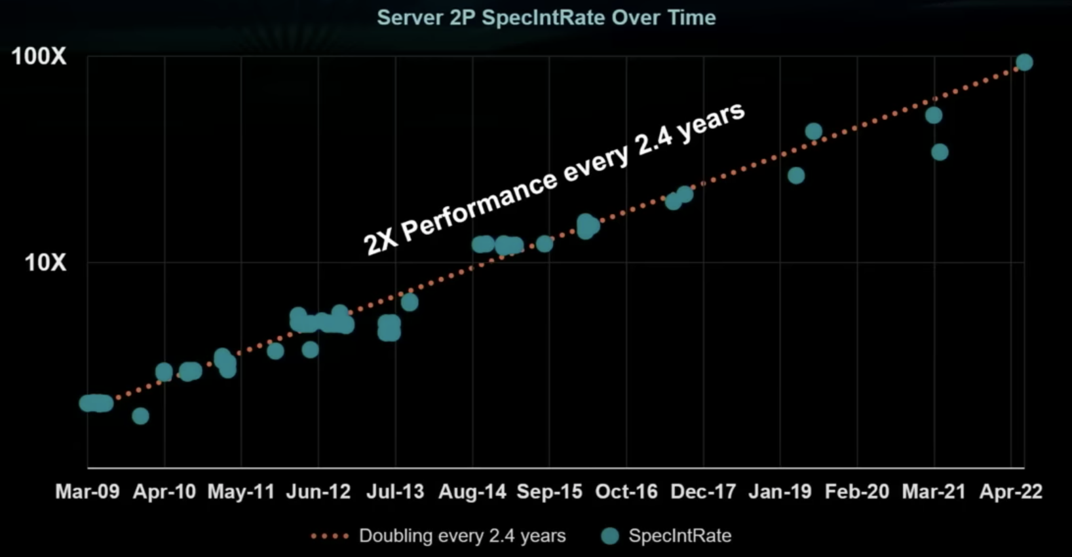
服务器的性能趋势

Slide 5
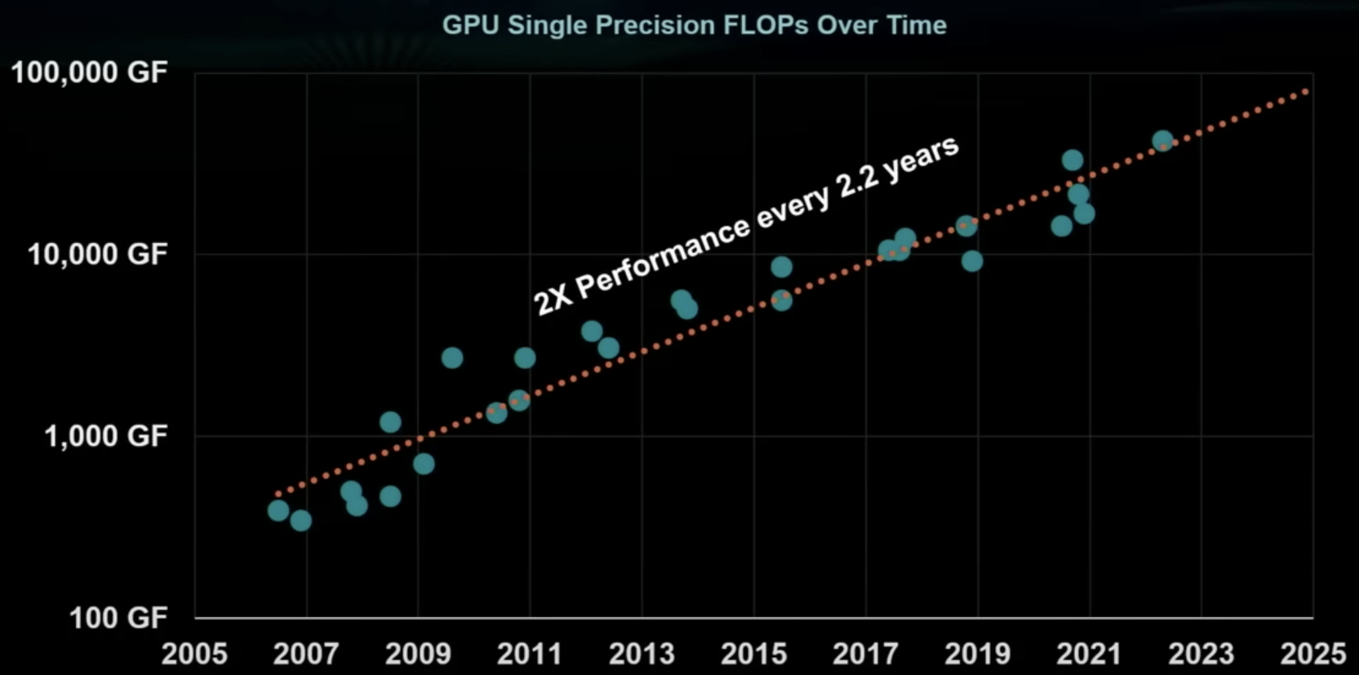
GPU 性能趋势

Slide 6
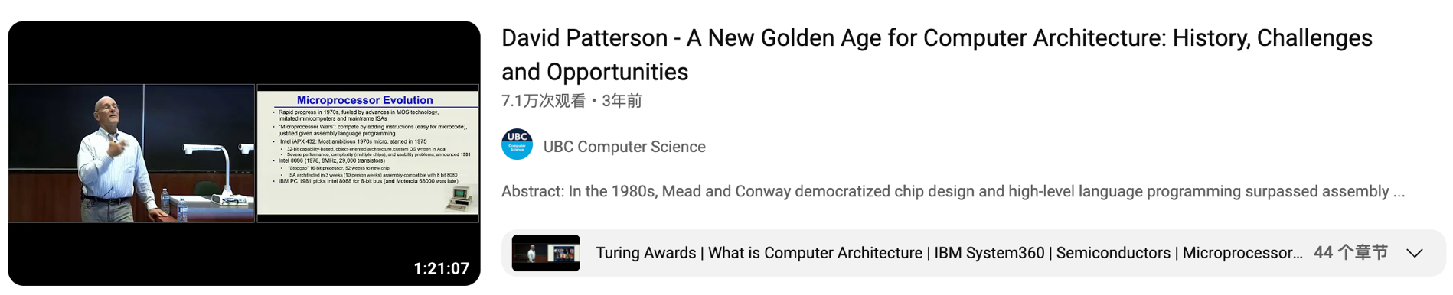
计算机架构的新黄金时代
A New Golden Age for Computer Architecture: History, Challenges and Opportunities https://www.youtube.com/watch?v=kFT54hO1X8M

Slide 7
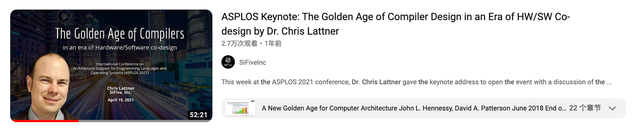
编译器的黄金时代
The Golden Age of Compiler Design in an Era of HW/SW Co-design
https://www.youtube.com/watch?v=4HgShra-KnY

Slide 8
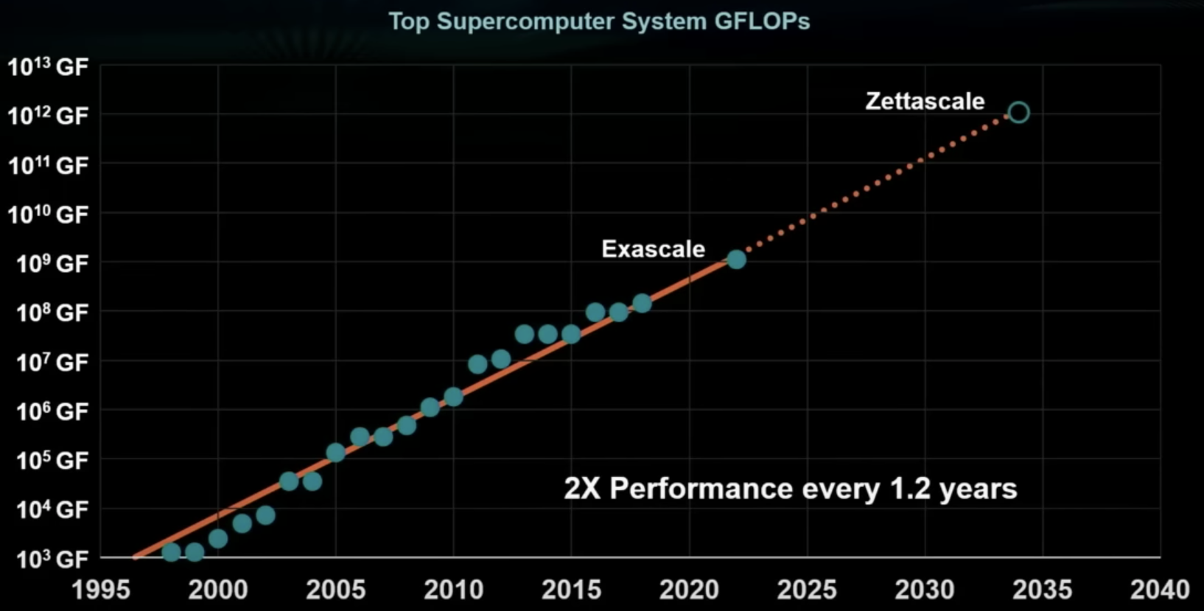
超算中心的性能

Slide 9
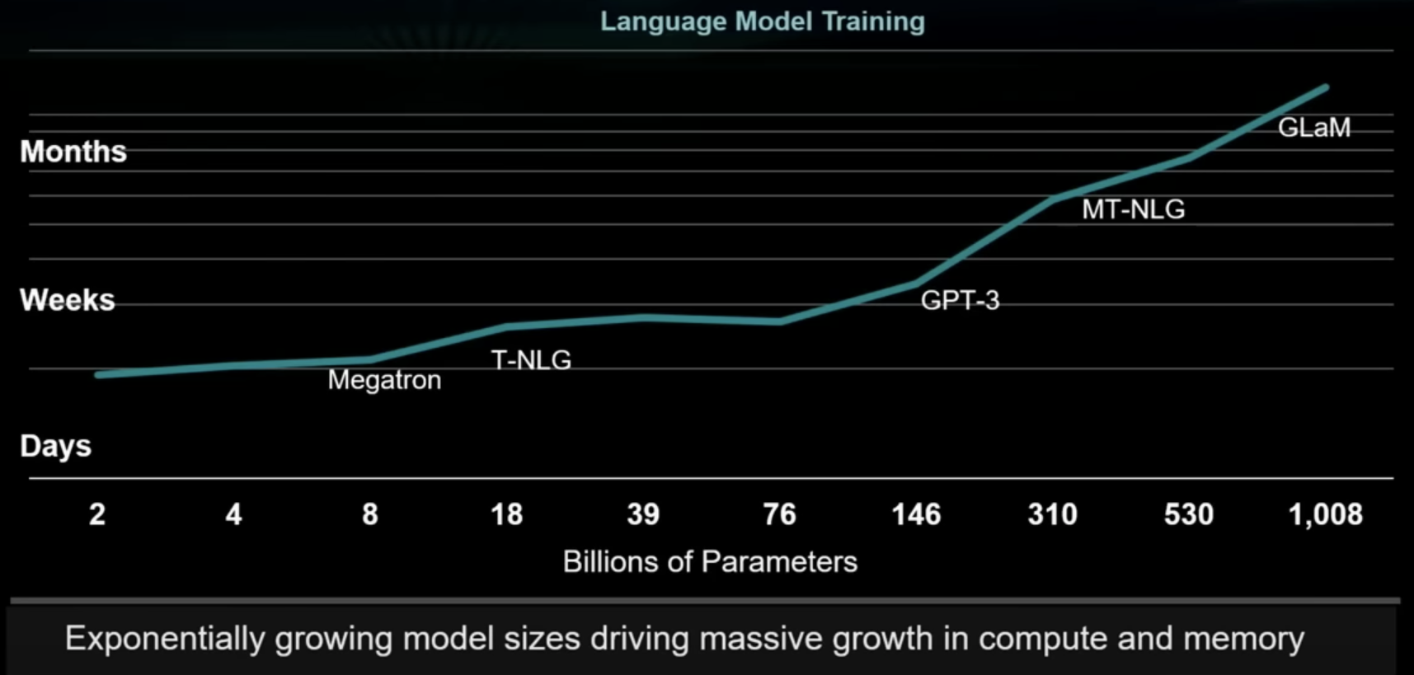
训练 AI 大模型的时间

Slide 10
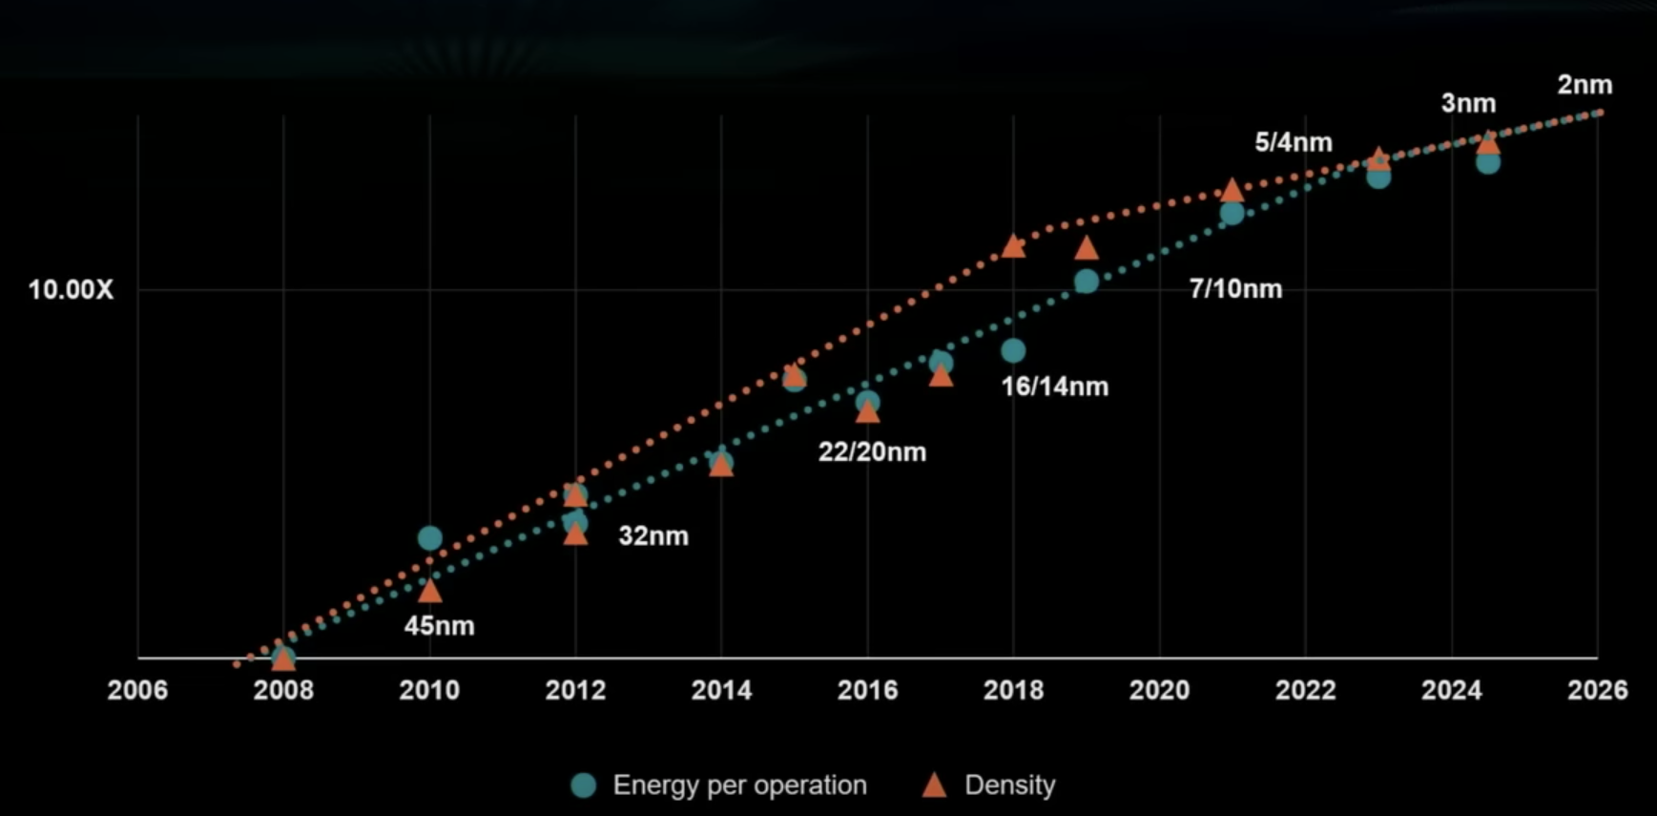
逻辑电路技术趋势预测

Slide 11

谁会在乎算力呢？

Slide 15
你真的在乎算力？

Slide 16
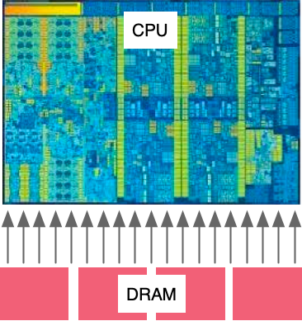

读取数据与计算的计算换算
How many operations must I do on some data to make it worth the cost of loading it?
2000 GFLOPs FP64
Required Compute Intensity = $\frac{FLOPs}{Data Rate}$ = 80
200 GBytes / sec
= 25 Giga-FP64 / sec
(FP64 = 8 bytes)
So for every number load from memory, Need to do 80 Operations on it to break even.

Slide 17
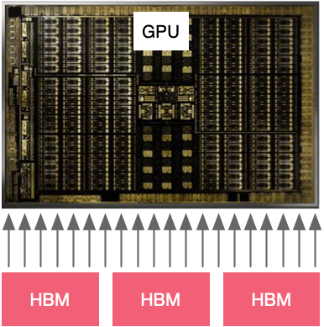
计算密集型
 | AMD Rome 7742 | Intel Xeon 8280 | NVIDIA A100
Peak FP64 Giga Flops | 2,190 | 2,300 | 19,500
Memory B/W (GB/sec) | 131 | 204 | 1,555
Compute Intensity | 134 | 90 | 100

Slide 18
ZOMI并不是很在乎算力

Slide 19
Performance(ops/sec)
MAC/Cycle
Bandwidth(BW)
Bounded
Compute
Bounded
Peak
Performance
Number of PEs (Theoretical Peak Performance)
BW to PEs
Operational intensity(ops/byte)
MAC/data
optimal
https://arxiv.org/abs/1807.07928

Slide 20
内存、带宽、时延
更应该关注

Slide 21
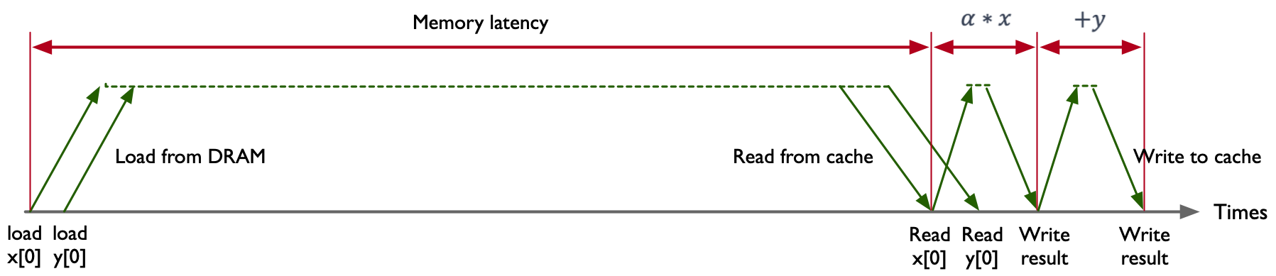
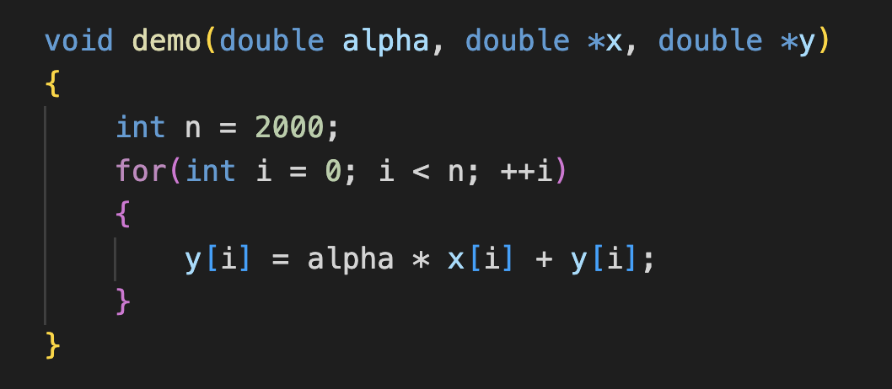
DAXPY 计算 DEMO
2FLOPs：multiply & add
2 Memory Loads: x[i] & y[i] (per element)
Single Operation: FMA(fused multiply-add)

Slide 22
光与电的传播速度
Speed of Light = 300,000,000 M/S
Computer Clock = 3,000,000,000 Hz
所以在一个时钟周期内光的传播速度为 100mm (~4 inches)

Slide 23
光与电的传播速度
Speed of Light = 300,000,000 M/S
Computer Clock = 3,000,000,000 Hz
Speed of Electricity = 60,000,000 M/S
所以在一个时钟周期电流的传播速度为 20mm (~0.8 inches)

Slide 24
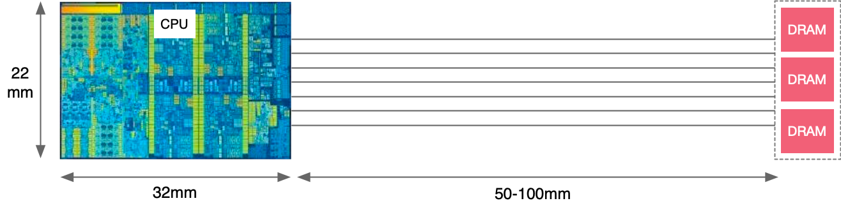
光与电的传播速度
Speed of Light = 300,000,000 M/S
Computer Clock = 3,000,000,000 Hz
Speed of Electricity = 60,000,000 M/S

Slide 25
处理器内部

Slide 26
DAXPY 计算 DEMO
Intel Exon 8280
Memory Bandwidth: 131 GB/sec
Memory latency: 89 ns
11,659 bytes can be moved in 89 ns
AXY demo move 16 byes per 89 ns latency
Memory efficiency = 0.14%
memory bus is idle 99.86% of the time

Slide 27
不同芯片产品的计算性能
 | AMD Rome 7742 | Intel Xeon 8280 | NVIDIA A100
Memory B/W(GB/sec) | 204 | 131 | 1555
DRAM Latency(ns) | 122 | 89 | 404
Peak bytes per latency | 24,888 | 11,659 | 628,220
Memory Efficiency | 0.064% | 0.14% | 0.0025%

Slide 28
Mythbusters Demo GPU versus CPU
https://www.youtube.com/watch?v=-P28LKWTzrI

Slide 29
引用
https://www.youtube.com/watch?v=3jHi8E5C-18
https://www.youtube.com/watch?v=-P28LKWTzrI
https://www.youtube.com/watch?v=3l10o0DYJXg

Slide 30
Notes:
30

